Slide 1

Database Keys
Primary key ◘ Unique key ◘ Foreign key
Manav Middha
Mohana Medisetty
Renukavalli Marepalli

Slide 2
Table of Contents
Recap…. Duh
What If there were no Database keys
Can and do Databases exist without keys
Are there databases that don't need keys

Slide 3

Recap
Primary Key: Any column in a table that can be used to uniquely identify each and every row in a table. Must be non nullable and unique
Unique Key can be used to uniquely identify each row in a table but can be nullable
Foreign Key is a field (or collection of fields) in one table, that refers to the primary column in another table. It is used prevent actions that would destroy links between two tables.

Slide 4

What if there were no Database Keys

Slide 5

No Primary Key and Unique Key
Leads to Data Duplication
Eg. A person shops in multiple stores. There is no unique or primary key constraint. His Id can be created multiple times.
Now VP of marketing asks me how many customers shopped in our stores?
The output that we get when we count the #customers will be incorrect.
Lack of personalization for customers
Wastage of marketing budget
Missing out on potential good customers

Slide 6

No foreign key
Potential data integrity problems
Difficulty with querying and reporting from the database

Slide 7
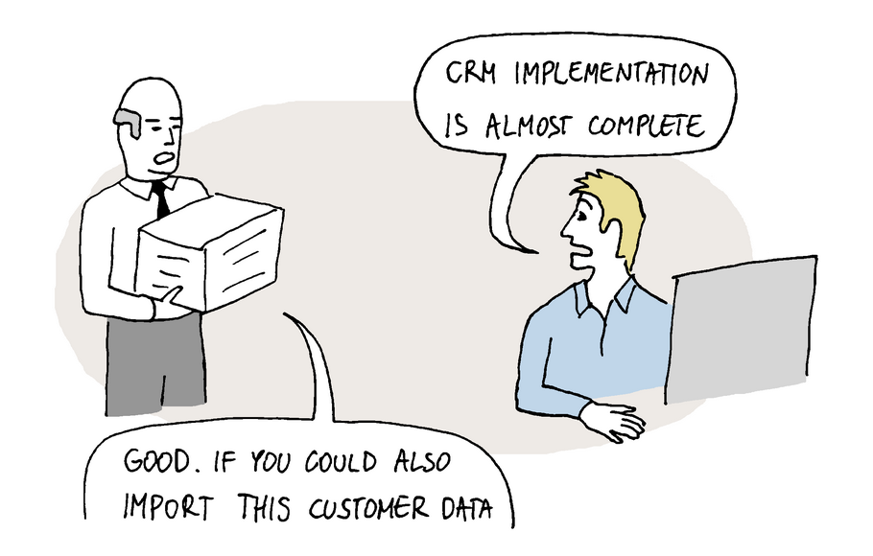
No foreign key - Scenarios
Effectiveness
Legacy data

Slide 8


No foreign key - Scenarios
Full Table Reload
Keep model a secret

Slide 9
Can and Do Relational Databases exist without keys - real world scenarios
Short Answer - yes, databases can and do exist without keys. But the problems we discussed can occur.
Personal experience - I have used database where I did not apply a foreign key constraint.
Insertion operation becomes expensive once we apply a foreign key constraint on a table
What if the entries are manual? Referential integrity constraint can cause the entire row to be dropped which will lead to loss of important information.

Slide 10
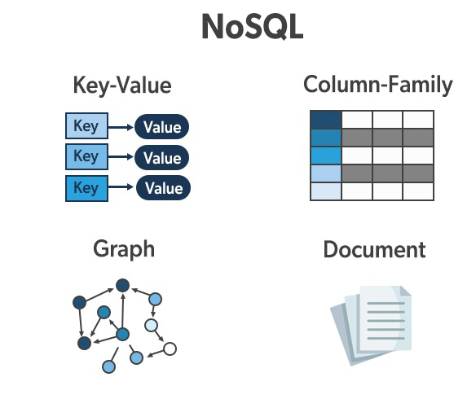
Are there databases that actually don't need keys ?
Yes ! Such databases are called Non relational databases or No SQL databases (Not only SQL).
No SQL DB’s need not have a defined table structure , schema, relations , rows, foriegn key constraints
NoSQL databases do not support foreign keys or joins and do not have the concept of referential integrity.
Notes:
https://www.cin.ufpe.br/~if695/arquivos/leituras/NoSQL_Dist%20-%20Column%20DB.pdf
https://www.guru99.com/nosql-tutorial.html

Slide 11
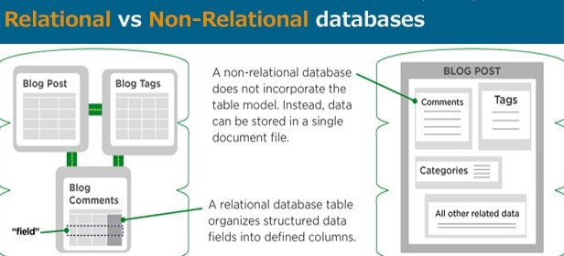
Example - Document based

Slide 12

Example - Document based

Slide 13
Conclusion
In summary, we have seen how keys are essential to a database , be it for structured (RDBMS) or unstructured ( NoSQL) data storage and retrieval .
Their role as unique identifiers for data storage /retrieval will be universal, irrespective of the type of database chosen.
Based on the kind of information , business requirements, need for scalability and various other factors DBA’s make informed decisions about the type of database to be chosen and effectively leverage keys in order to maintain data integrity.

Slide 14
No foreign key
There can be data corruption and inconsistency - Suppose a value is deleted in a primary key of the parent table, but with no foreign key constraint, that value will still exist in the child table with no business value on its own or orphaned.
Table relations will not be clear to a person who doesn’t know the schema

Slide 15
No Primary Key and Unique keys
Indexes may be bigger than they need to be.
All access to the table will either be through Full table scans or secondary index lookups
Inserts may be somewhat slower as the internal key has to be generated for all rows as they’re inserted.
Redundancy in data For instance, users with same identifier would be created multiple times

